Slide 1
Drone Phenology Monitoring
Gaurav Rajput
Parth Thakur

Slide 2
Overview
Recent progress
Working Segmentation(SAM Model)

Slide 3
SAM Model
We Implemented Sam Model as recommended in the mid term presentation and we are finally getting good Segmentation.

Slide 4
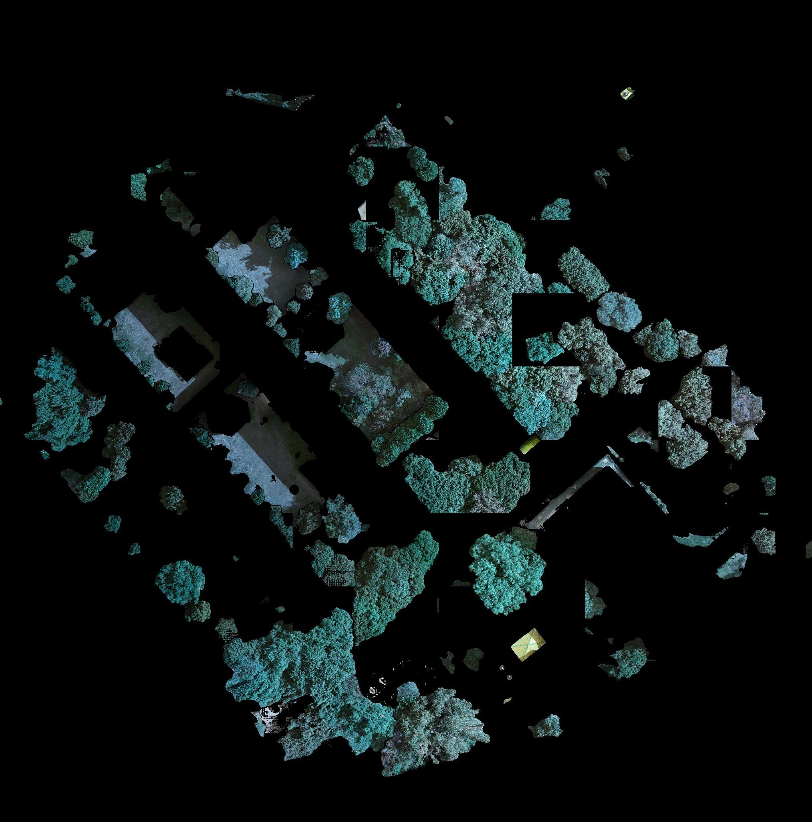

Slide 5
Currently what we are doing
We are working on taking sam model’s output to detectree2 to predict crown and then overlay that on the geotiff image
exploring algorithms to accurately combine crowns across different outputs
id each detected tree to do phonology tacking

Slide 6
Euclidean Distance-Based Matching
Extract metrics from each detected tree crown (coordinates, crown radius, area)
Calculate the Euclidean distance between crowns
Link each tree crown to its closest match according to this distance metric

Slide 7
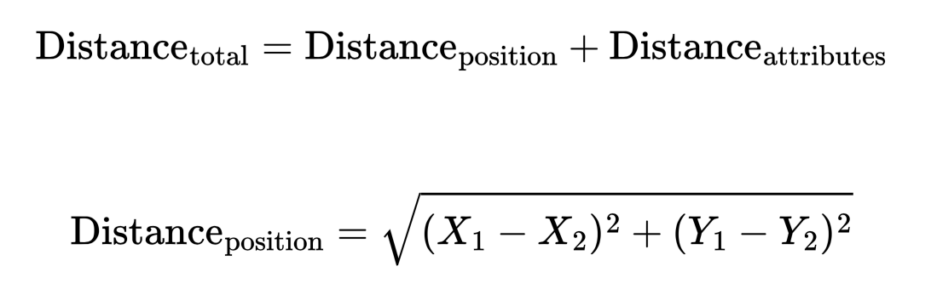
Euclidean Distance-Based Matching
This approach has been implemented for aligning field-surveyed trees with detected individual tree crowns, https://pmc.ncbi.nlm.nih.gov/articles/PMC6330952/

Slide 8
IoU-Based Overlap Matching
Compare each detected tree crown in different orthomosaics and measure how much they overlap using Intersection over Union (IoU).
How It Works:
Compute the IoU score between crowns from different orthomosaics.
If IoU > threshold (e.g., 0.75), the crowns are considered the same tree.
Assign the same tree ID to matching crowns.

Slide 9
IoU-Based Overlap Matching
for each polygon in orthomosaic_1:
for each polygon in orthomosaic_2:
if calculate_IoU(polygon_1, polygon_2) >= 0.75:
record_match(polygon_1, polygon_2)
We can also use a combination of these algorithms: First, Apply IoU criteria to identify high-confidence matches then For remaining unmatched crowns, use Euclidean distance-based methods incorporating crown attributes

Slide 10
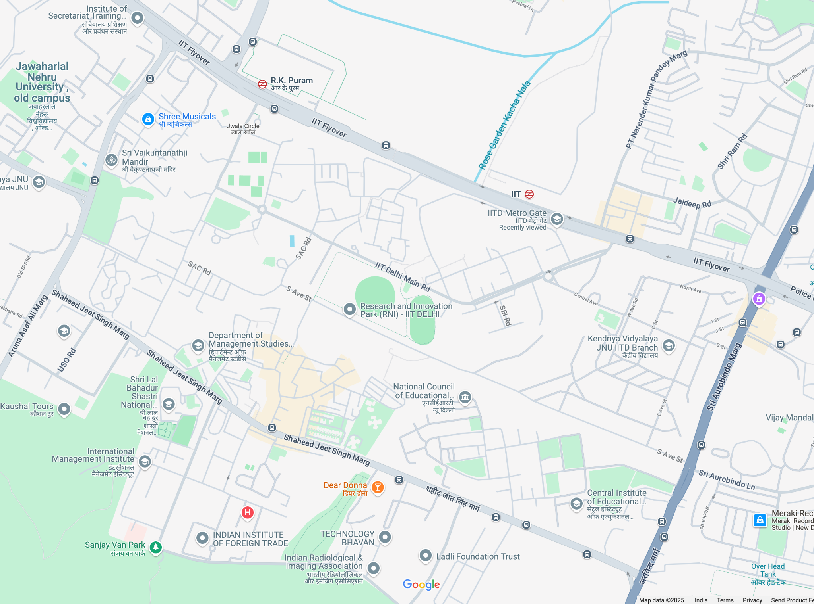
Sites to start profiling

Slide 11
GPU
We have got the access of GPU workstation and sshd with the help of raman sir.

Slide 12
What we have to do?
Discuss sites on campus that we should start profiling.
Decide on algorithms which will help us to combine crowns on different runs.

Slide 13
Thank you

